Slide 1
Approaches to Ontology Creation
Barry Smith
http://ontologist.com

Slide 2
Alan
Ontology = one part of information systems
Ontologies in different information systems will never talk to each other
Ontologies should be robust reference frameworks to which information systems point

Slide 3
Alan
Ontology = concept system model
Classes: fracture, thyroid gland, breast cancer, LPC1 gene
Concepts: fracture without intracranial injury, probable breast cancer

Slide 4
class names concept names

Slide 5
deep knowledge of reality on the left
class names concept names

Slide 6
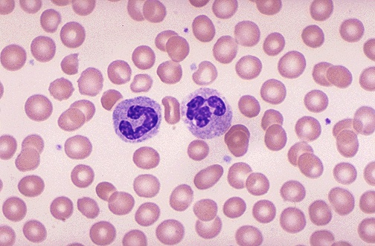
class names concept names

Slide 7
class names concept names

Slide 8
class names concept names

Slide 9
concept names

Slide 10
bad (concepts) drive out good (classes)
concept names

Slide 11
bad (concepts) drive out good (classes)
concept names
the world is lost
(Kantianism) (HL7-RIM)

Slide 12
bad (concepts) drive out good (classes)
concept names
the world is lost
(Kantianism)

Slide 13
bad (concepts) drive out good (classes)
concept names
the world is replaced by a system of arbitrary conventions

Slide 14
bad (concepts) drive out good (classes)
concept names
the world is lost
(HL7-RIM)

Slide 15
bad (concepts) drive out good (classes)
concept names
to manipulate the wild language and wild definitions allowed in the unconstrained realm of concepts
weak logics must be used

Slide 16
Semantic Web
exists, unconstrained, on the level of mere concepts
confuses syntactic regimentation with ontology
(analogous to making everyone use the same font)
to talk about leprechauns

Slide 17
Description Logic
attempt to provide DL definitions a valuable exercise
but not every DL defined term corresponds to a genuine class
rabbit-or-breast-cancer
FMA: methodology for definitions tailored for biomedical domain

Slide 18
Description Logic
gives precise semantics
but in terms of set-theoretic artefacts
shifts target from classes in the domain of an ontology to abstract mathematical surrogates

Slide 19
Kent
same term used in different ways by different communities
fundus_{A}, fundus_{B}, fundus_{C}, fundus_{D}
but how do they relate to each other?

Slide 20

different conceptual systems

Slide 21
need not interconnect at all

Slide 22

we cannot make distinct concept-systems interconnect
just by looking at concepts,
or knowledge or models –
we need some tertium quid

Slide 23
Reference ontology should provide this tertium quid
top-level reference ontology
(BFO / DOLCE ...)
domain ontologies (ARO-FMA ...)
NOT ‘just-in-time’
GET IT RIGHT
(basic science)

Slide 24
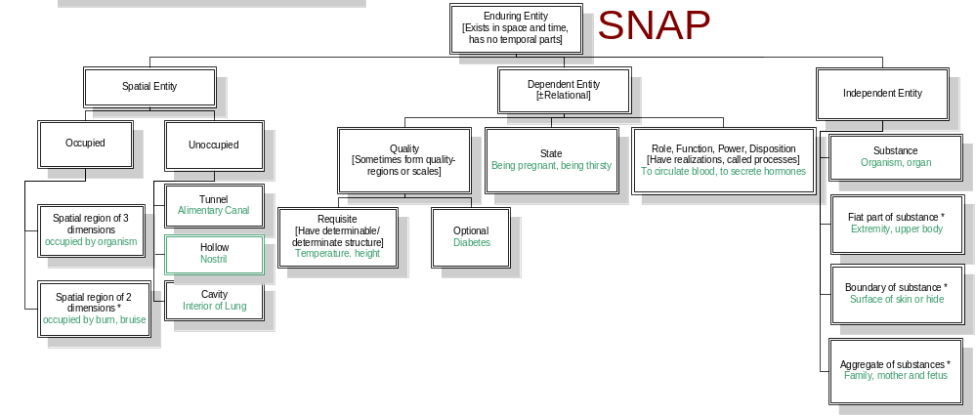
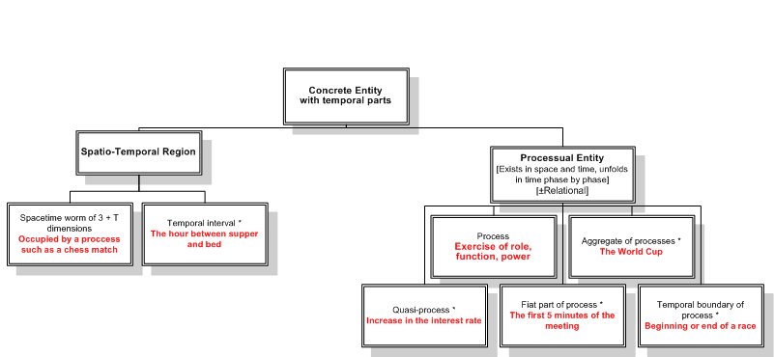
SPAN

